Slide 1
Hardware Software Science Co-design in the Human Brain Project
Wouter Klijn
02-12-2016
Sastra University, India
Notes:
I would like to thank Sriram Shankar and Sastra for the opportunity to speak, it is not often that you get the chance to come to such a beautiful country and to talk about something I'm passionate about.
The titels stresses one of the core tenets of the HBP, the close interaction between scientist and engineers on all levels, because big questions can not solved be either alone.

Slide 2
Content
The Human Brain Project
Hardware
HBP Pilot machines
Software
A Neuron
NestMC: NEST Multi Compartment
Science use-case
Large brain areas
Cortical dynamics
Summary / discussion
Notes:
In my talk I will touch upon the following subjects, starting with a general introduction to the human brain project, its scale and funding, goals and structure.
This will be followed with a look at the hardware, bought for the HBP, the Pre Commercial Procurement Machines (Which I will call the PCP or Pilot Machines for the remainder of the talk). Ill talk about the reasoning behind building these machines and some details of the tech.
Next to the software
I have kept the amount of neuroscience to a minimum, but to understand the role and functionality of NestMC I will talk a little bit about what makes a neuron and the abstractions used in out simulator. And how we make it fit to the hardware.
I will finish with two Science Use-case
Both regarding the simulation of large (orders bigger then current state of the art) brain simulations and how the requirements of these use-cases influence our development
- Conclusion

Slide 3
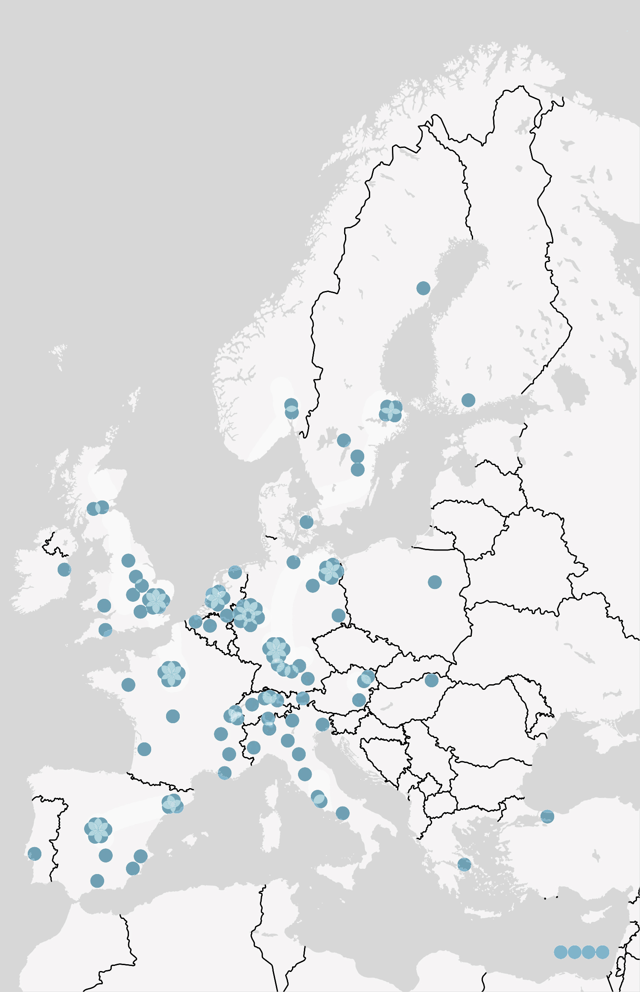
Human Brain Project
Future and Emerging Technologies Flagship project
More than 400 scientists from 112 institutions representing 24 countries
“Flagships are visionary, science-driven, large-scale research initiatives addressing grand Scientific and Technological challenges”
Notes:
Graphene is the second flagship
FET Flagships: http://ec.europa.eu/programmes/horizon2020/en/h2020-section/fet-flagships
Flagships are visionary, science-driven, large-scale research initiatives addressing grand Scientific and Technological (S&T) challenges.
They are long-term initiatives bringing together excellent research teams across various disciplines,
sharing a unifying goal and an ambitious research roadmap on how to achieve it.
Started on 1 October 2013
There was a successful review by the European Commission and the second phase money has been awarded.
And until now a total of 274 publications by the hundreds of scientists and institutions.
http://ec.europa.eu/programmes/horizon2020/en/h2020-section/fet-flagships
https://www.humanbrainproject.eu/2016-publications

Slide 4
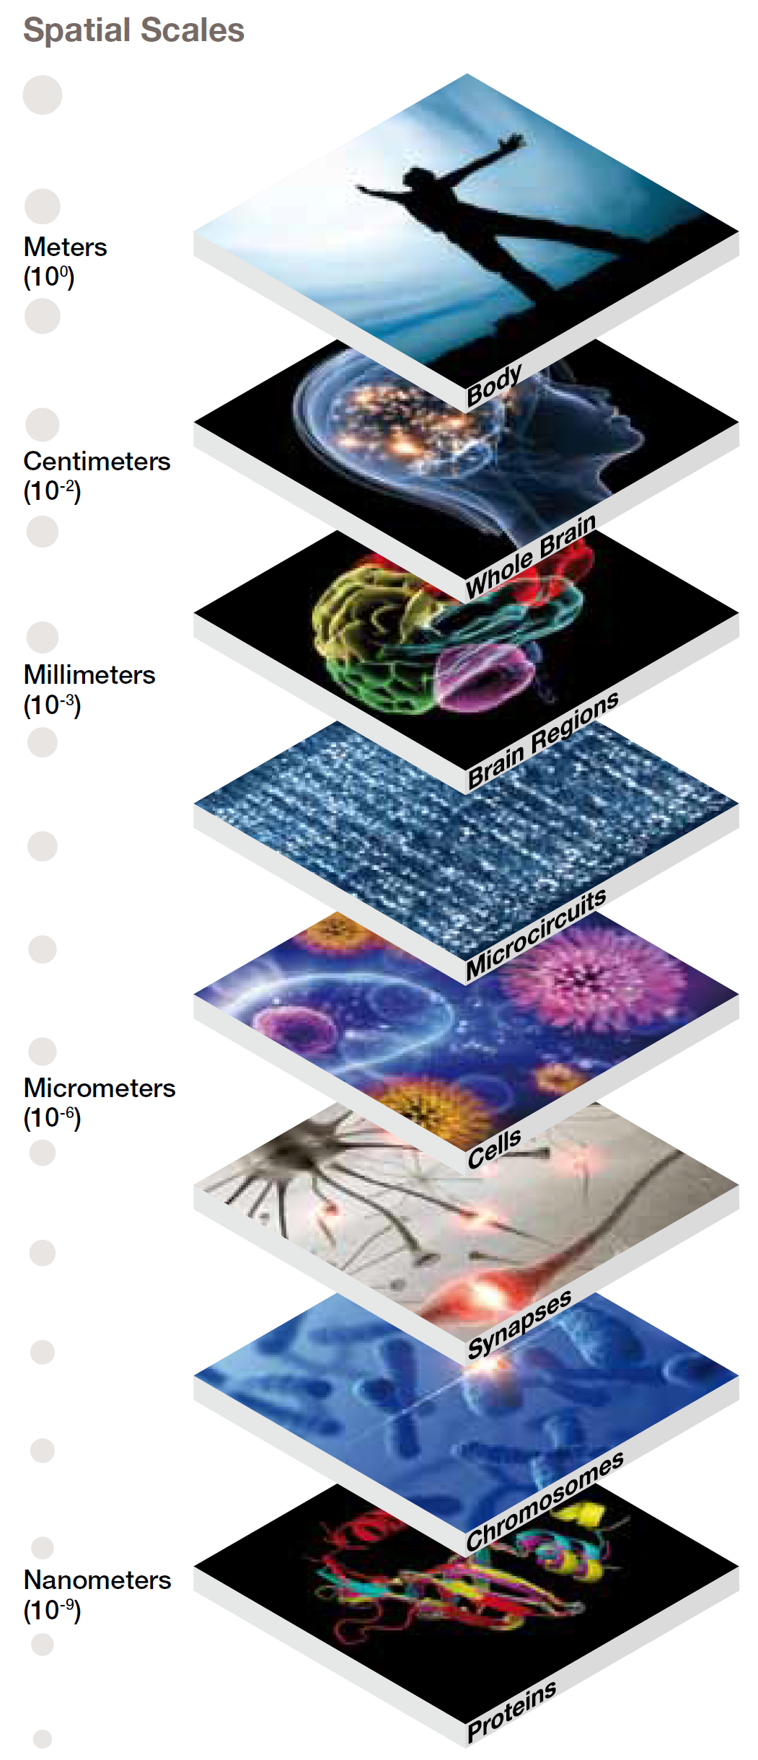
Human Brain Project
A 10-year €1 billion Euro project
Mental health: €800 per year billion in Europe
Challenges
The most complex object in the known galaxy
Multiple scales
Multiple organizational levels
Brain uses 30 Watt for 100 Billion neurons
Notes:
On this slide I give you a rough overview of the size, of the challenges we are meeting.
First the size of the project, in the amount of money for one. This has influence on the governance structure needed but also, but this is my person al opinion and the responsibility we have. But to put that price tag in perspective: In Europe alone we spend this amount 800 hundred times per year.
Then there are the challenges of a more fundamental nature. The brain is complex, it is the most complex object in the know galaxy. The brain’s functioning is influenced by biological mechanism with multiple orders of size difference. From the proteins in the cell membrane to the whole brain. All parts work together. And that for only 30 Watts of power.
To put that into context, again, if we were to simulate the brain with current techniques, we would need a nuclear plants.
(100*E9 neurons, 100*E12 synapses)

Slide 5
Human Brain Project Objectives
Simulation of the brain
Brain-inspired computing and robotics
Interactive supercomputing
Map brain diseases
HBP Brain Atlas
Integrated European scientific research infrastructure
Sustainable organization
Research and collaboration
Full brain scale
30 Watts
Scientist in the HPC loop
Big-data patient data
Merge multi level data
Supporting science
Long term vision
Notes:
Simulation of the brain The current tools do not allow us to run simulations at scale, one of the major efforts is therefore into this direction. And looking a little bit forward, the NestMC project is part of this effort
Brain-inspired computing and robotics
With 30 Watts of power doing all the stuff we are doing, nature is clearly onto something. Why not copy this?
Interactive Supercomputing
HPC is getting a bigger role in most science fields, but typically these computers are used in a hands-off fashion: Jobs are deployed and results get back hours or days later. By integrating visualization we want to put the scientist back in the loop.
Map brain diseases
Develop ICT tools to federate and cluster anonymized patient data.
Create HBP Brain Atlas
Integrate multilevel maps of the mouse brain and the human brain. Current
Integrated European scientific research infrastructure
Build an integrated European scientific research infrastructure to support advances in the HBP’s three scientific areas of interest: Neuroscience, Computing and Medicine
Sustainable organization
Develop a rational and sustainable organization and funding structure, built around a Legal Entity to continue operating under the aegis of international organization after the end of the HBP
Research and collaboration
Catalyse revolutionary new research and research collaboration

Slide 6
HBP pilot systems
Julia (Ju + glia)
Juron ( Ju + neuron)
Notes:
The obligatory shot of the PCP machines. Don’t worry, ill show the inside also. But it is interesting to see the difference. With CRAY on the left with a nice decal. And well IBM, being all business.
The names are based on the two most common cell types in the brain. The neurons, about ten percent and then the Glia cells. Making up about 90 Percent of the cells. If you were wondering, Yes, this is probably to source of the only using 10% of your brain idea that has been flowing around in pop science.

Slide 7
HBP Pilot systems
Observation: Mismatch between science needs and currently available systems
Research (Pre) Exascale supercomputing architectures
Drivers:
Dense Memory Integration
Dynamic resource management
Scalable visualization and steering
Tender to prospective suppliers
Notes:
Remote visualization and steering is meant to test the scientist in the HPC compute loop.
Dense Memory integration I would typically see used by the big data use-cases: integrating neuroscientific data from multiple levels (FMRI, Genes, proteins, PLI, tensor, etc,etc.)
The machines are expected to run a large amalgam of different softwares, and even within a single application a large number of different softwares might be used. Not all optimized for GPUs or other many core systems. We need to use our resources optimally and to dynamically adapt to changes
TODO: Tender information by Dirk
HBp heeft dus hpc nodig. Echter wat er geboden werd dekt niet goed wat hbp nodig heft.

Slide 8
Julia
Juron
CRAY, CS-400 / CS-Storm
Compute Nodes (60):
Intel KNL (Xeon Phi) 7230 @ 1.30GHz
64 cores (x4), 96GB DDR4, 16GB MCDRAM
Visualization Nodes (4):
Intel Broadwell, 28 cores, 128GB DDR4
4 NVIDIA GPU K40
Connectivity:
Intel 100GB OmniPath
10GB Uplink
Dense Memory Integration
4 DataWarp Nodes, Intel Broadwell, 28 cores, 128GB DDR4
2 NVMe, Intel P3600, 1.6 TB
IBM/NVIDIA, Minsky
Compute Nodes (18):
POWER8 @3.32Ghz 20 cores (8SMT), 256 GB DDR4
4x NVIDIA Pascal 100, NVLink
Visualization Nodes (4):
4 Pascal 100, NVLink
Connectivity:
Mellanox Connectx4 100GB EDR Infiniband
10GB uplink, NVLink
Dense Memory Integration
HGST SN100 series, 1.6 TB
Notes:
http://www.cray.com/products/computing/cs-series
http://ark.intel.com/products/94034/Intel-Xeon-Phi-Processor-7230-16GB-1_30-GHz-64-core
www.cray.com/sites/default/files/resources/CrayXC40-DataWarp.pdf
http://www.intel.com/content/www/us/en/solid-state-drives/ssd-dc-p3600-spec.html

Slide 9
NEST Multi Compartment : NestMC
Notes:
Nest is a project by scientist located in the CSCS in Zurich ( No I will not attempt to pronounce that). Barcelona Supercomputing Centre and the Julich Forschungszentrum.
And we are part of the NEST initiative.

Slide 10
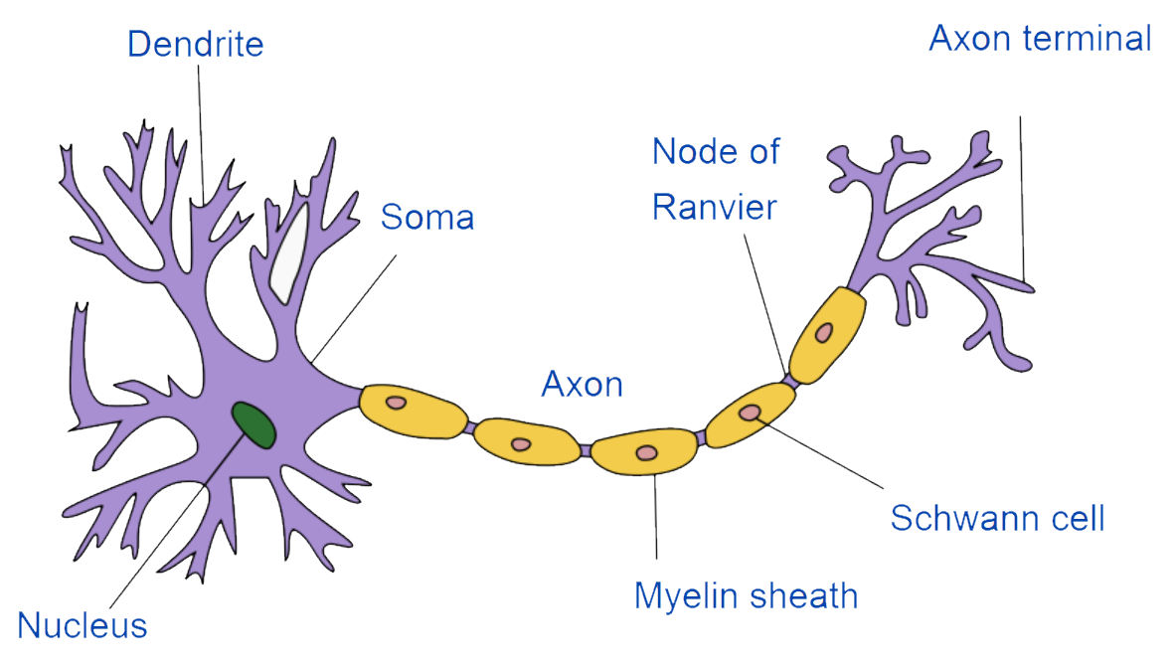
NestMC
CSCS
Ben Cumming
Stuart Yates
Vasileios Karakasis
Julich
Alexander Peyser
Wouter Klijn
Yachau Shau
BSC
Ivan Martinez
Pedro Valero
Notes:
https://en.wikipedia.org/wiki/Neuron
On the right you see a schematic overview of a neuron. And these little things are the cause of all the commotion. And the reason you see me standing here: Your eyes are an outgrow of the brain. I don’t know about the soul, but when you look very deep in someone's eyes, you are looking at someone's, well, brain.
General talk about the neuron, blabla
Information from dendrite to axon.
Brain is electic.
Dendrite is a branched tree structure. The axon the telegraph sending information forward. With the some adding all input up.

Slide 11
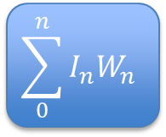
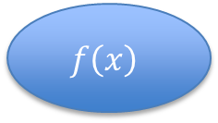
NestMC vs Artificial Neuron
W0
W1
$$\sum_{0}^{n}{I_{n}W_{n}}$$
$$f\left(x\right)$$
W…
Wn
Notes:
We start with the standard image of the artificial neuron.
The input incoming from the rest. They are multiplied with the weights W.
Summed and then a transfer function resulting in the output.
I used 6 boxes to draw this figure, the NestMC neuron will take up the rest of the page.

Slide 12
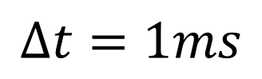
NestMC vs Artificial Neuron
$$∆t=1ms$$
W0
W1
$$\sum_{0}^{n}{I_{n}W_{n}}$$
$$f\left(x\right)$$
W…
Wn
Notes:
I start out with drawing the schematic dendrite segments. This is for two neurons, blue and green.
I do want to draw your attention to the diameter. This has influence on the conductance, and the resulting membrane potential.

Slide 13
NestMC vs Artificial Neuron
$$∆t=1ms$$
W0
W1
$$\sum_{0}^{n}{I_{n}W_{n}}$$
$$f\left(x\right)$$
W…
Wn
Notes:
The segments can have mechanism, channels that react to the environment and the membrane potential. Lots of exponentials and this expensive calculations. I have drawn one, but.

Slide 14
NestMC vs Artificial Neuron
$$∆t=1ms$$
W0
W1
$$\sum_{0}^{n}{I_{n}W_{n}}$$
$$f\left(x\right)$$
W…
Wn
Notes:
They are located all over the dendrite

Slide 15
NestMC vs Artificial Neuron
$$∆t=1ms$$
W0
W1
$$\sum_{0}^{n}{I_{n}W_{n}}$$
$$f\left(x\right)$$
W…
Wn

Slide 16
NestMC vs Artificial Neuron
$$∆t=1ms$$
W0
W1
$$\sum_{0}^{n}{I_{n}W_{n}}$$
$$f\left(x\right)$$
W…
Wn
Notes:
And the other neuron.

Slide 17
NestMC vs Artificial Neuron
$$∆t=1ms$$
W0
W1
$$\sum_{0}^{n}{I_{n}W_{n}}$$
$$f\left(x\right)$$
W…
Wn

Slide 18
NestMC vs Artificial Neuron
$$∆t=1ms$$
W0
W1
$$\sum_{0}^{n}{I_{n}W_{n}}$$
$$f\left(x\right)$$
W…
Wn
Notes:
So now we have the first part of the neuron, what is missing is the input.

Slide 19
NestMC vs Artificial Neuron
$$∆t=1ms$$
W0
W1
$$\sum_{0}^{n}{I_{n}W_{n}}$$
$$f\left(x\right)$$
W…
Wn
Notes:
I added three synapses.

Slide 20
NestMC vs Artificial Neuron
$$∆t=1ms$$
W0
W1
$$\sum_{0}^{n}{I_{n}W_{n}}$$
$$f\left(x\right)$$
W…
Wn
Notes:
I will now go thru a small ‘simulation’. I add two inputs on two different synapses, Bottom negative. Top positive.
The traces you see are all the same time range.
The two inputs are not at the same time, they are a little offset.

Slide 21
NestMC vs Artificial Neuron
$$∆t=1ms$$
W0
W1
$$\sum_{0}^{n}{I_{n}W_{n}}$$
$$f\left(x\right)$$
W…
Wn
Notes:
The input current spreads accross the membrane two the next segments.

Slide 22
NestMC vs Artificial Neuron
$$∆t=1ms$$
W0
W1
$$\sum_{0}^{n}{I_{n}W_{n}}$$
$$f\left(x\right)$$
W…
Wn
Notes:
But, the bottom segment is bigger, and the potential spreads faster.
The segments them self do not have a direction.
The potential will spread to both sides.

Slide 23
NestMC vs Artificial Neuron
$$∆t=1ms$$
W0
W1
$$\sum_{0}^{n}{I_{n}W_{n}}$$
$$f\left(x\right)$$
W…
Wn
Notes:
And this is the resulting potential at the juncation. The two weights cancel out.
And you can even see some negative potential spreading back up the dendrite.

Slide 24
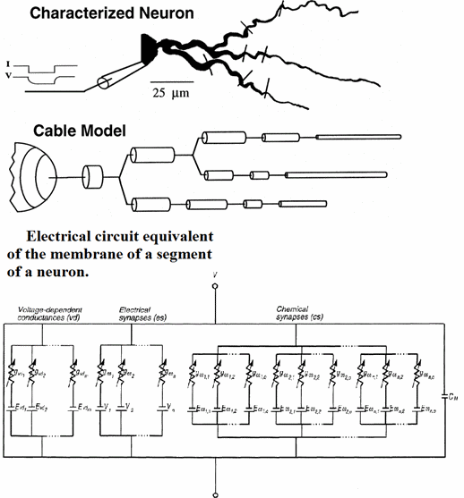
NestMC
Basic unit of modeling frustum
Balance the currents
Synapses, voltage dependent conductances (expensive)
The magic sauce:
Almost all calculations are completely independent
Parallel at multiple levels
Redistribution and segmentation for coalesced memory access
Notes:
https://commons.wikimedia.org/wiki/File:Real_neuron,_cable_model_and_compartmental_models.gif

Slide 25
NestMC - Why?
Existing simulator have a long history and large ‘essential’ feature space
Technical debt
Refactoring for Highly parallel architectures is non-trivial
Not all features work in highly parallel setting
The opportunity to build for future HPC hardware:
Highly parallel architecture: intel KNL, GPU
Wide vector operations: AVX512
Specialized accelerator hardware: GPU, FPGA
Co-design of new and complicated use-cases

Slide 26
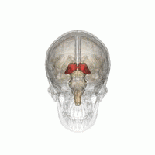
Use-Case 1: Brain region
Large scale simulation of whole brain regions: 4E6 neurons
Existing software requires large BGP cluster for simulation of 2E5
Morphemically detailed neurons: 1000s of compartments
Biologically detailed: Stochastic release of neuro-transmitters
Large number of random numbers
Models are described in existing language: NMODL
Support existing interfaces
Notes:
https://commons.wikimedia.org/wiki/File:Thalamus_small.gif

Slide 27
Use-Case 1
Close contact with the science team:
Joined slack channel and open source code
Creation of project goals based on analysis. Setting of priorities by scientist
Validation of results, programmatically and by scientists
Examples:
Kinetic schemes for stochastic models. Essential for model thus has the highest priority
Random number generation. After discussion alternative method designed

Slide 28

Use-Case 2: Cortical dynamics
Dynamics of large cortical network with biological density
50000 neurons per mm2 dynamics occur on > cm2 scale
Influence of synapse location
Partially simulation of the cortex
Injection of random currents
Existing models are implemented in existing simulator
Support of existing Python interface (NEST)
Notes:
https://commons.wikimedia.org/wiki/File:Migraine_aura.jpg

Slide 29
Use-Case 2
Neuroscientist joins developer team
Translation of science use cases into requirements
Part of normal development cycle. Work on unrelated issues (strength in numbers)
Examples:
Review of existing models in neuroscientific literature
Implementation of proof of concept with proto-type code, 4 days effort for a working model
Implementation of Poisson generator with biological characteristics.
Hackaton planned to add Python support

Slide 30
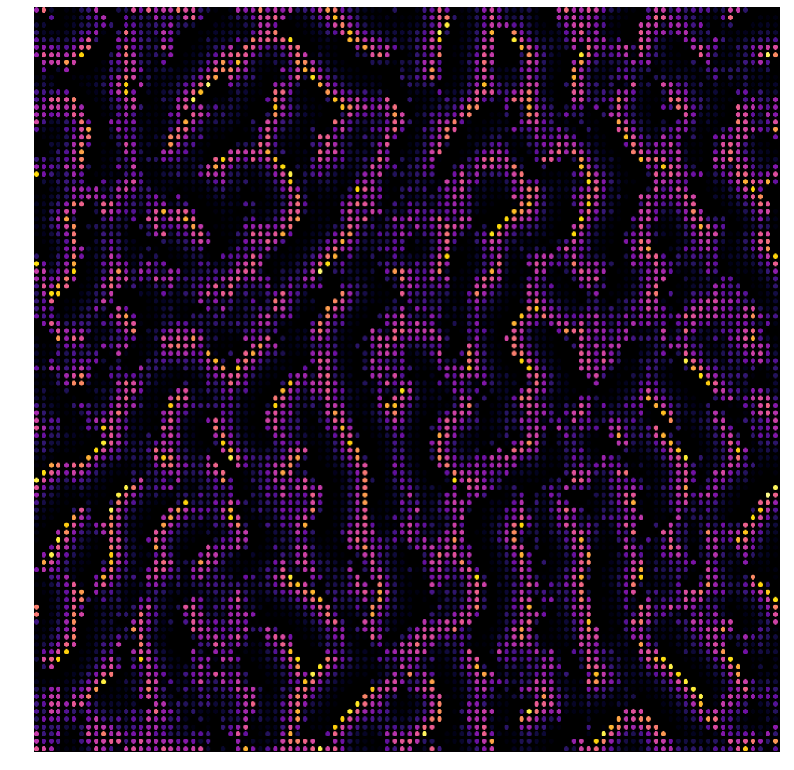
Use-Case 2
100001 Neurons
100 compartments
90 connections per neuron in a biological plausible ‘Mexican hat’ activation
Each neuron gets random input from 1000 neurons

Slide 31
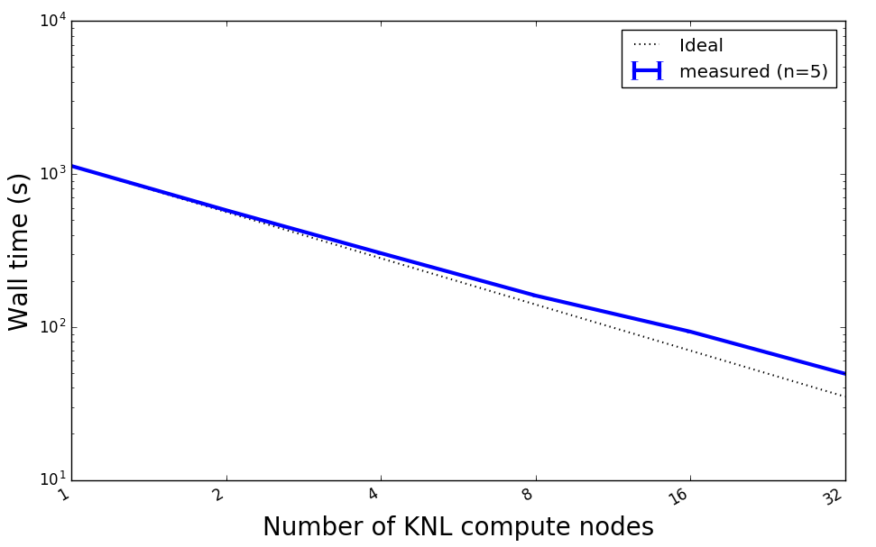
Prototype strong scaling Julia
Tread occupancy 95% to 99.5%

Slide 32
Use-case lessons learned
Our working model is loosely based on the AGILE / SCRUM methodology
Scientist as stake holder
Use-case driven
You need buy-in from developers and scientists
Compared to industry more ‘discussion’ with ‘management’
Access to the hardware allows rapid iterations in development cycle
Bleeding edge technology features are not yet discussed on stackoverflow

Slide 34
Prototype design
Modular: Components can be easily exchanged according to internal API
‘Thin’ API via type parameterization to allow low –overhead data communication (internally and externally)

Slide 35
Prototype status
Finite-volume based discretization
Distributed model instantiation
Spike and voltage trace output
X86 multi-core and Intel KNL
Synapse and ion-channel descriptions in NMODL
Code generation
Unit and validation testing suite
GPU support (first iteration)
Open source: https://github.com/eth-cscs/nestmc-proto

Slide 36
Prototype benchmarks
Test case
500 ms simulation
350 compartments per cell and 2000 synapses
HH mechanism on the cell some, passive dendrites
Random network
50 Hz spiking rate
36 Core Cray system

Slide 37
Prototype benchmarks
Weak scaling

Slide 38
Use-case Pilot system benchmark
100001 Neurons
100 compartments
90 connections per neuron in a biological plausible ‘Mexican hat’ activation
Each neuron gets random input from 1000 neurons

Slide 39
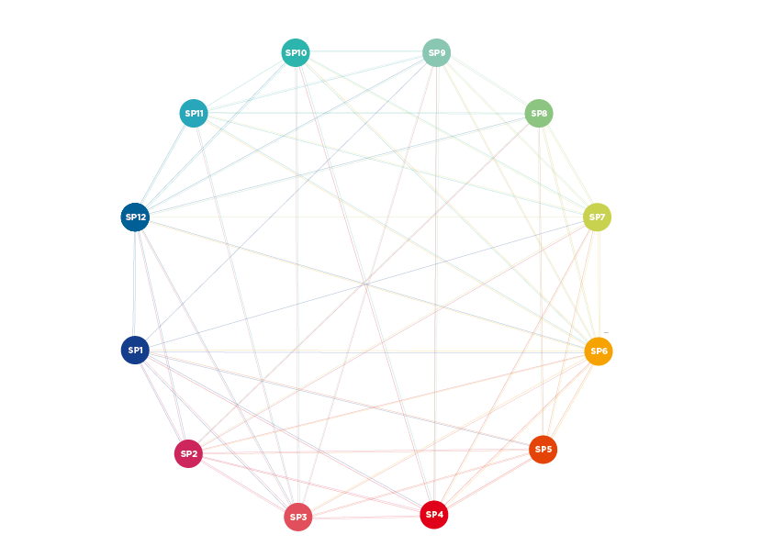
Human Brain Project
Organized in twelve subprojects to further six informatics based platforms
Neuroinformatics
Brain Simulation
Medical Informatics
Neuromorphic Computing
Neurorobotics
HPC
Brain organisation
Cognitive neuroscience
Theory
Ethics and society
Management
Notes:
The HBP is organized in twelve subprojects, spanning the development of six new informatics-based platforms, plus brain organisation, cognitive neuroscience, theory, ethics and society and management

Slide 40

NestMC vs Artificial Neuron
$$∆t=1ms$$
W0
W1
$$\sum_{0}^{n}{I_{n}W_{n}}$$
$$\frac{}{1+ {}^{}}$$
W…
Wn
Notes:
Naturally there is a reason for the second neuron.
Dendrites of different neurons can and will make direct connections: called gap junctions. These connection connect the potential of the two neurons directly together.

Slide 41
NestMC vs Artificial Neuron
$$∆t=1ms$$
W0
W1
$$\sum_{0}^{n}{I_{n}W_{n}}$$
$$\frac{}{1+ {}^{}}$$
W…
Wn
Notes:
A the second neuron had a positive potential, which spreads.

Slide 42
NestMC vs Artificial Neuron
$$∆t=1ms$$
W0
W1
$$\sum_{0}^{n}{I_{n}W_{n}}$$
$$\frac{}{1+ {}^{}}$$
W…
Wn
Notes:
And results in a potential in the blue neuron.

Slide 43
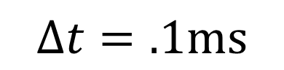
NestMC vs Artificial Neuron
$$∆t=1ms$$
W0
W1
$$\sum_{0}^{n}{I_{n}W_{n}}$$
$$\frac{}{1+ {}^{}}$$
W…
Wn
$$∆t=.1ms$$
Notes:
So we have a difference in the structure of the neuron, also the time step is typically allot smaller. All these components are updated every tenth of a millisecond.
And, this is a schematic view. A real neuron can have ten thousand segments.
With hundreds of mechanisms per segment. With typically ten different mechanism.

